Slide 1
Sofosbuvir-Velpatasvir with Minimal Monitoring +/- HCV/HIV Coinfection ACTG A5360 (MINMON)
Treatment Naïve, Phase 4
Source: Solomon SS, et al. Lancet Gastroenterol Hepatol. 2022;7:307-17.

Slide 2
Sofosbuvir-Velpatasvir with Minimal Monitoring +/- HIV Coinfection ACTG A5360 (MINMON): Study Overview
Design: Phase 4 open-label single-arm trial to examine the safety and efficacy of a minimal monitoring approach to HCV care delivery using 12 weeks of sofosbuvir-velpatasvir in treatment-naïve patients
Setting: Multiple sites in Brazil, South Africa, Thailand, Uganda & United States
Entry criteria:
Chronic HCV infection as determined by HCV RNA >1000 IU/ml
Treatment-naïve
Age 18 or older
HIV coinfection permitted
Compensated cirrhosis permitted (FIB-4 ≥3.25, capped at ≤20% participants)
Absence of coinfection with HBV
Primary End-point: SVR ≥22 weeks post-treatment initiation
Source: Solomon SS, et al. Lancet Gastroenterol Hepatol. 2022;7:307-17.

Slide 3
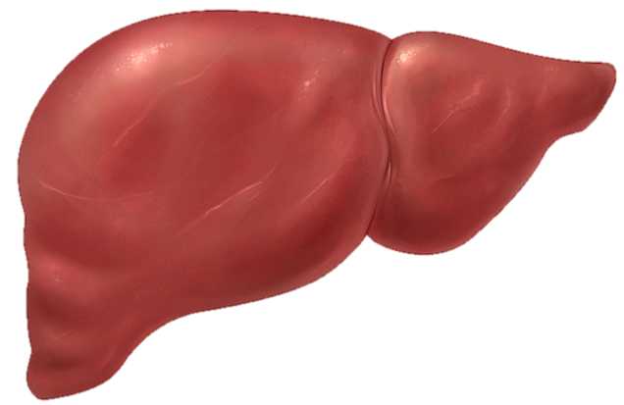
Sofosbuvir-Velpatasvir with Minimal Monitoring +/- HIV Coinfection ACTG A5360 (MINMON):
No Genotype
No pre-treatment genotyping
Cirrhosis determination based on Fib-4
All treatment medication provided at entry
No scheduled on treatment visits/labs
Remote contact at weeks 4 and 22
X
Cirrhosis Status by Fib-4
SVR
Sofosbuvir-Velpatasvir (SOF-VEL)
All pills provided at Entry
0
4
8
12
16
20
22
24
Sofosbuvir-Velpatasvir
Week
Source: Solomon SS, et al. Lancet Gastroenterol Hepatol. 2022;7:307-17.

Slide 4
Sofosbuvir-Velpatasvir with Minimal Monitoring +/- HIV Coinfection ACTG A5360 (MINMON): Trial Design
Week
0
12
22
Screened n = 508
Eligible n = 400*
Sofosbuvir-Velpatasvir
SVR10 or later**
Screen Failures (n =108)
Ineligible ( n= 72)
Never returned (n = 31)
Declined (n = 1)
Enrollment closed (n = 2)
Other (n=2)
Drug Dosing Sofosbuvir-velpatasvir: 400/100 mg once daily
*Final analytic set was n = 399 since one study participant never started SOF-VEL
**SVR ascertainment permitted out to week 76 of study
Source: Solomon SS, et al. Lancet Gastroenterol Hepatol. 2022;7:307-17.

Slide 5
Sofosbuvir-Velpatasvir with Minimal Monitoring +/- HIV Coinfection ACTG A5360 (MINMON): Study Population
Baseline Characteristic | Sofosbuvir-Velpatasvir (n = 399)
Age, median (range) | 47 (20-82)
Female sex at birth, n (%) | 139 (35)
Identity across transgender spectrum, n (%) | 22 (6)
Race, n (%) White Black Asian | 166 (42) 72 (18) 113 (28)
HCV RNA log₁₀ IU/mL, median (IQR) | 6.1 (5.6 – 6.6)
Current injection drug use, n (%) | 12 (3)
Current alcohol use, n (%) | 161 (40%)
Cirrhosis (by FIB-4 ≥3.25), n (%) | 34 (9)
HIV coinfection, n (%) Suppressed on antiretroviral therapy, n (% of HIV/HCV) | 166 (42) 164 (99)
IQR, interquartile range; FIB-4, Fibrosis-4 index
Source: Solomon SS, et al. Lancet Gastroenterol Hepatol. 2022;7:307-17.

Slide 6
Sofosbuvir-Velpatasvir with Minimal Monitoring +/- HIV Coinfection ACTG A5360 (MINMON): Results, Overall and by HIV Status
(95% CI, 92-97)
(95% CI, 92-97)
(95% CI, 90-97)
379/399
222/233
157/166
Source: Solomon SS, et al. Lancet Gastroenterol Hepatol. 2022;7:307-17.

Slide 7
Sofosbuvir-Velpatasvir with Minimal Monitoring +/- HIV Coinfection ACTG A5360 (MINMON): Results by Cirrhosis Status
(95% CI, 93-97)
(95% CI, 73-95)
30/34
349/365
Source: Solomon SS, et al. Lancet Gastroenterol Hepatol. 2022;7:307-17.

Slide 8
Sofosbuvir-Velpatasvir with Minimal Monitoring +/- HIV Coinfection ACTG A5360 (MINMON): Results by Injection Drug Use Status
(95% CI, 85-98)
(95% CI, 93-98)
(95% CI, 92-98)
11/12
116/124
252/263
Source: Solomon SS, et al. Lancet Gastroenterol Hepatol. 2022;7:307-17.

Slide 9
Sofosbuvir-Velpatasvir with Minimal Monitoring +/- HIV Coinfection ACTG A5360 (MINMON): Results by Age
(95% CI, 93-98)
(95% CI, 89-99)
(95% CI, 69-93)
28/33
280/292
71/74
Source: Solomon SS, et al. Lancet Gastroenterol Hepatol. 2022;7:307-17.

Slide 10
MINMON Study: Sofosbuvir-velpatasvir with minimal monitoring Results by HCV Genotype
(95% CI, 90-99)
(95% CI, 87-100)
(95% CI, 87-100)
(95% CI, 89-97)
(95% CI, 83-96)
166/177
70/72
26/26
73/80
26/26
Source: Solomon SS, et al. Lancet Gastroenterol Hepatol. 2022;7:307-17.

Slide 11
MINMON Study: Sofosbuvir-velpatasvir with minimal monitoring Study events
15 (3.8%) participants with following events:
n=3 adverse events (AE)
n=8 abnormal lab values at baseline
n=6 non-AE clinical events
3 participants reported losing medications
1 after 14 days on study
2 received replacement (interruption: 4 and 7 days)
2 participants reported premature discontinuation
One loss of medications, one due to AE
Source: Solomon SS, et al. Lancet Gastroenterol Hepatol. 2022;7:307-17.

Slide 12
Sofosbuvir-Velpatasvir with Minimal Monitoring +/- HIV Coinfection ACTG A5360 (MINMON): Conclusions
Interpretation: “In this diverse global population of people with HCV, the MINMON approach with sofosbuvir–velpatasvir treatment was safe and achieved SVR comparable to standard monitoring observed in real-world data. Coupled with innovative case finding strategies, this strategy could be crucial to the global HCV elimination agenda.”
Source: Solomon SS, et al. Lancet Gastroenterol Hepatol. 2022;7:307-17.

