Slide 1
Harm Reduction Approaches for the Prevention of HCV Transmission via Injection Drug Use
Maria Corcorran, MD, MPH
Assistant Professor
Division of Allergy and Infectious Diseases
University of Washington
Last updated: May 24, 2023
Notes:
Hello, I’m Dr. Maria Corcorran from the University of Washington. In this Hepatitis C Online mini-lecture, I will discuss harm reduction approaches to prevent the transmission of hepatitis c via injection drug use.

Slide 2
Disclosures
Dr. Corcorran does not have any disclosures.

Slide 3
Objectives
Review the epidemiology of hepatitis C virus (HCV) infection and injection drug use.
Briefly review other infectious complications of injection drug use.
Discuss harm reduction strategies to prevent the transmission of HCV among people who inject drugs (PWID).
Syringe service programs (SSPs)
Medications for opioid use disorder (MOUD)
Notes:
In this talk I will provide a brief review of the epidemiology of hepatitis C and injection drug use as well as the infectious complications that can result as a consequence of injection drug use. I will then discuss the principles of harm reductions and outline two evidence-based interventions, including syringe service programs and medications for opioid use disorder, that have been shown to reduce the risk for HCV transmission, including the risk for HCV reinfection.

Slide 4
Injection Drug Use and Risk for HCV
Injection drug use remains the most common risk factor for acquiring HCV in the United States.
In 2020, among persons with acute HCV and available risk behavior information, 66% reported a history of injection drug use in the prior 6 months.
Injection drug use is also a driving risk factor for reinfection with HCV, with reinfection rates estimated to be between 5 and 6 per 100 person-years.
Centers for Disease Control and Prevention. Viral Hepatitis Surveillance Report – United States, 2020.
Clin Infect Dis. 2016 Mar 15;62(6):683-694
J Hepatol. 2020 Apr;72(4):643-657
Notes:
Injection drug use remains the most commons risk factor for hepatitis C infection in the United States, as well as in many other countries across the world. In the most recent CDC Viral Hepatitis Surveillance Report, 66% of persons with acute HCV, for whom risk factor data was available, reported a history of injection drug use in the prior 6 months. Injection drug use is also the main driver of HCV reinfection, and large systematic reviews and meta-analyses have estimated the rate of reinfection to be between 5 to 6 cases per 100 person-years among people who inject drugs. That being said, smaller individual studies suggest the reinfection rate could be higher.

Slide 5
Epidemiology of Injection Drug Use in the United States
In the past decade, there has been an increase in injection drug use across the U.S., owing to the opioid epidemic and rising rates of stimulant and synthetic opioid use.
2011: 774,434 PWID (0.30% of U.S. population ≥13yrs)
Likely considerable underestimate d/t basis on pop-level survey data
2018: 3,694,500 (1.46% of adult population)
Bradley H, et. al. Estimated number of people who inject drugs in the United States. Clin Infect Dis. 2022 Jul 6:ciac543.
Notes:
In the past decade, there has been a significant increase in injection drug use across the U.S., largely owing to the opioid epidemic and rising rates of stimulant and synthetic opioid use. In 2011 there were an estimated 774,434 persons who injected drugs in the U.S.; however, the estimated number of PWID rose to nearly 3.7 million in 2018, which equated to 1.46% of the adult population.

Slide 6
Estimated Case Numbers of Acute Hepatitis C Virus Infection United States, 2010-2020
Source: CDC. 2020 Viral Hepatitis Surveillance. August 2022.
Notes:
Given the strong correlation between hepatitis C and injection drug use, it should therefore be no surprise that cases of acute hepatitis c, a marker for incidence, continue to rise. In this graph, which uses data from the CDC’s most recent Viral Hepatitis Surveillance report, you can see that the estimated number of acute HCV infections in the United States has increased from approximately 10,000 in 2010 to nearly 70,000 in 2020.

Slide 7
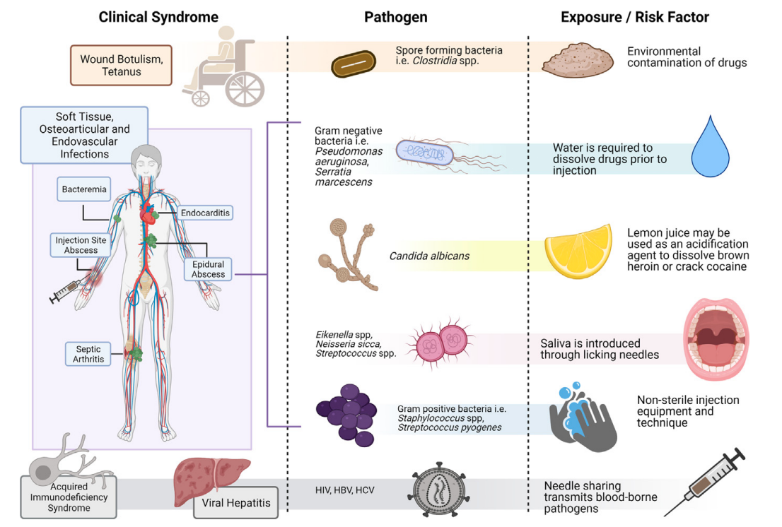
Other Infectious Complication of Injection Drug Use
Reprinted from Med Clin North Am, 2022 Jan;106(1), Marks LR, Nolan NS, Liang SY, Durkin MJ, Weimer MB. Infectious Complications of Injection Drug Use, pages 187-200, ©2022 with permission from Elsevier
Notes:
However, hepatitis C is not the only infectious complication of injection drug use, and persons who inject drugs are at risk for a number of other viral, bacterial and fungal infections depending on how they use drugs. As depicted in this figure, there are several different clinical syndrome that can results from injection drug use, including wound botulisms, tetanus, skin and soft tissue infections, osteoarticular infections like osteomyelitis and septic arthritis, endovascular infections like bacteremia and endocarditis, HIV and other forms of viral hepatitis, including hepatitis B.

Slide 8
What is Harm Reduction?
In the context of substance use, harm reduction is a set of practices and ideas focused on reducing the negative consequences associated with drug use.
A harm reduction philosophy accepts that substance use occurs in our society and aims to minimize the harmful effects of substance use through strategies that are respectful, non-judgmental, and meet people “where they’re at.”
National Harm Reduction Coalition. https://harmreduction.org/about-us/principles-of-harm-reduction/
Notes:
Harm reduction represents a practical set of strategies and ideas focused on reducing the negative consequences of drug use. In the context of substance use, a harm reduction philosophy accepts that substance use occurs in our society and aims to minimize the harmful effects of substance use through individual and community strategies that are respectful, non-judgmental and meet people where they’re at.

Slide 9
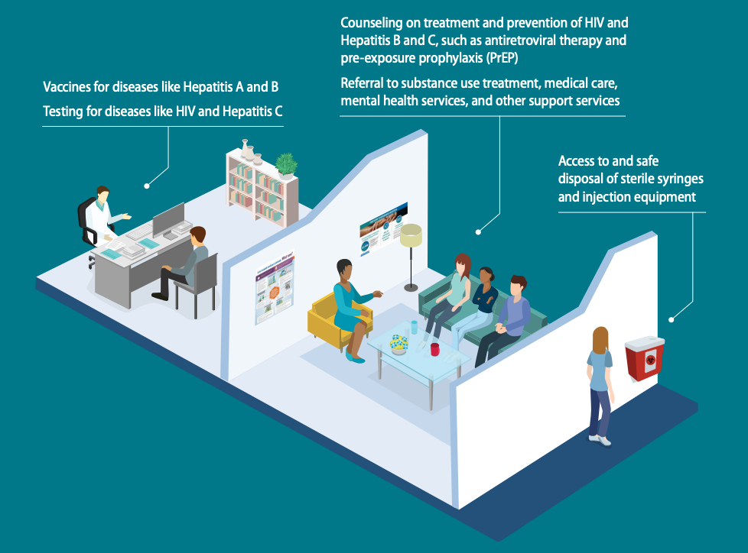
Syringe Service Programs
Centers for Disease Control and Prevention. What are Syringe Service Programs (SSPs), https://www.cdc.gov/ssp/docs/Syringe-Services-Program-Infographic_508.pdf
Notes:
Syringe service programs, or SSPs, are one of the most well known harm reduction interventions to mitigate the negative effects of substance use. SSPs offer a harm reduction approach to reducing the spread of infectious diseases, including hepatitis C and HIV. These community-based prevention programs offer a range of different health services including access to sterile syringes and injection equipment, as well as safe disposal of used injection equipment. Many also offer testing for HIV and hepatitis C, vaccination against hepatitis A and B, counseling on treatment and prevention of HIV and viral hepatitis, and referral to substance use treatment, mental health services, and other medical care. The CDC reports that SSPs are associated with an estimated 50% reduction in HIV and hepatitis C incidence, and when combined with medications that treat opioid use disorder, HIV and hepatitis C transmission is reduced by over two-thirds. SSPs have also been shown to save lives by lowering the likelihood of deaths from overdoses, and new users of SSPs are five times more likely to enter drug treatment and three times more likely to stop using drugs than those who do not use the program.

Slide 10
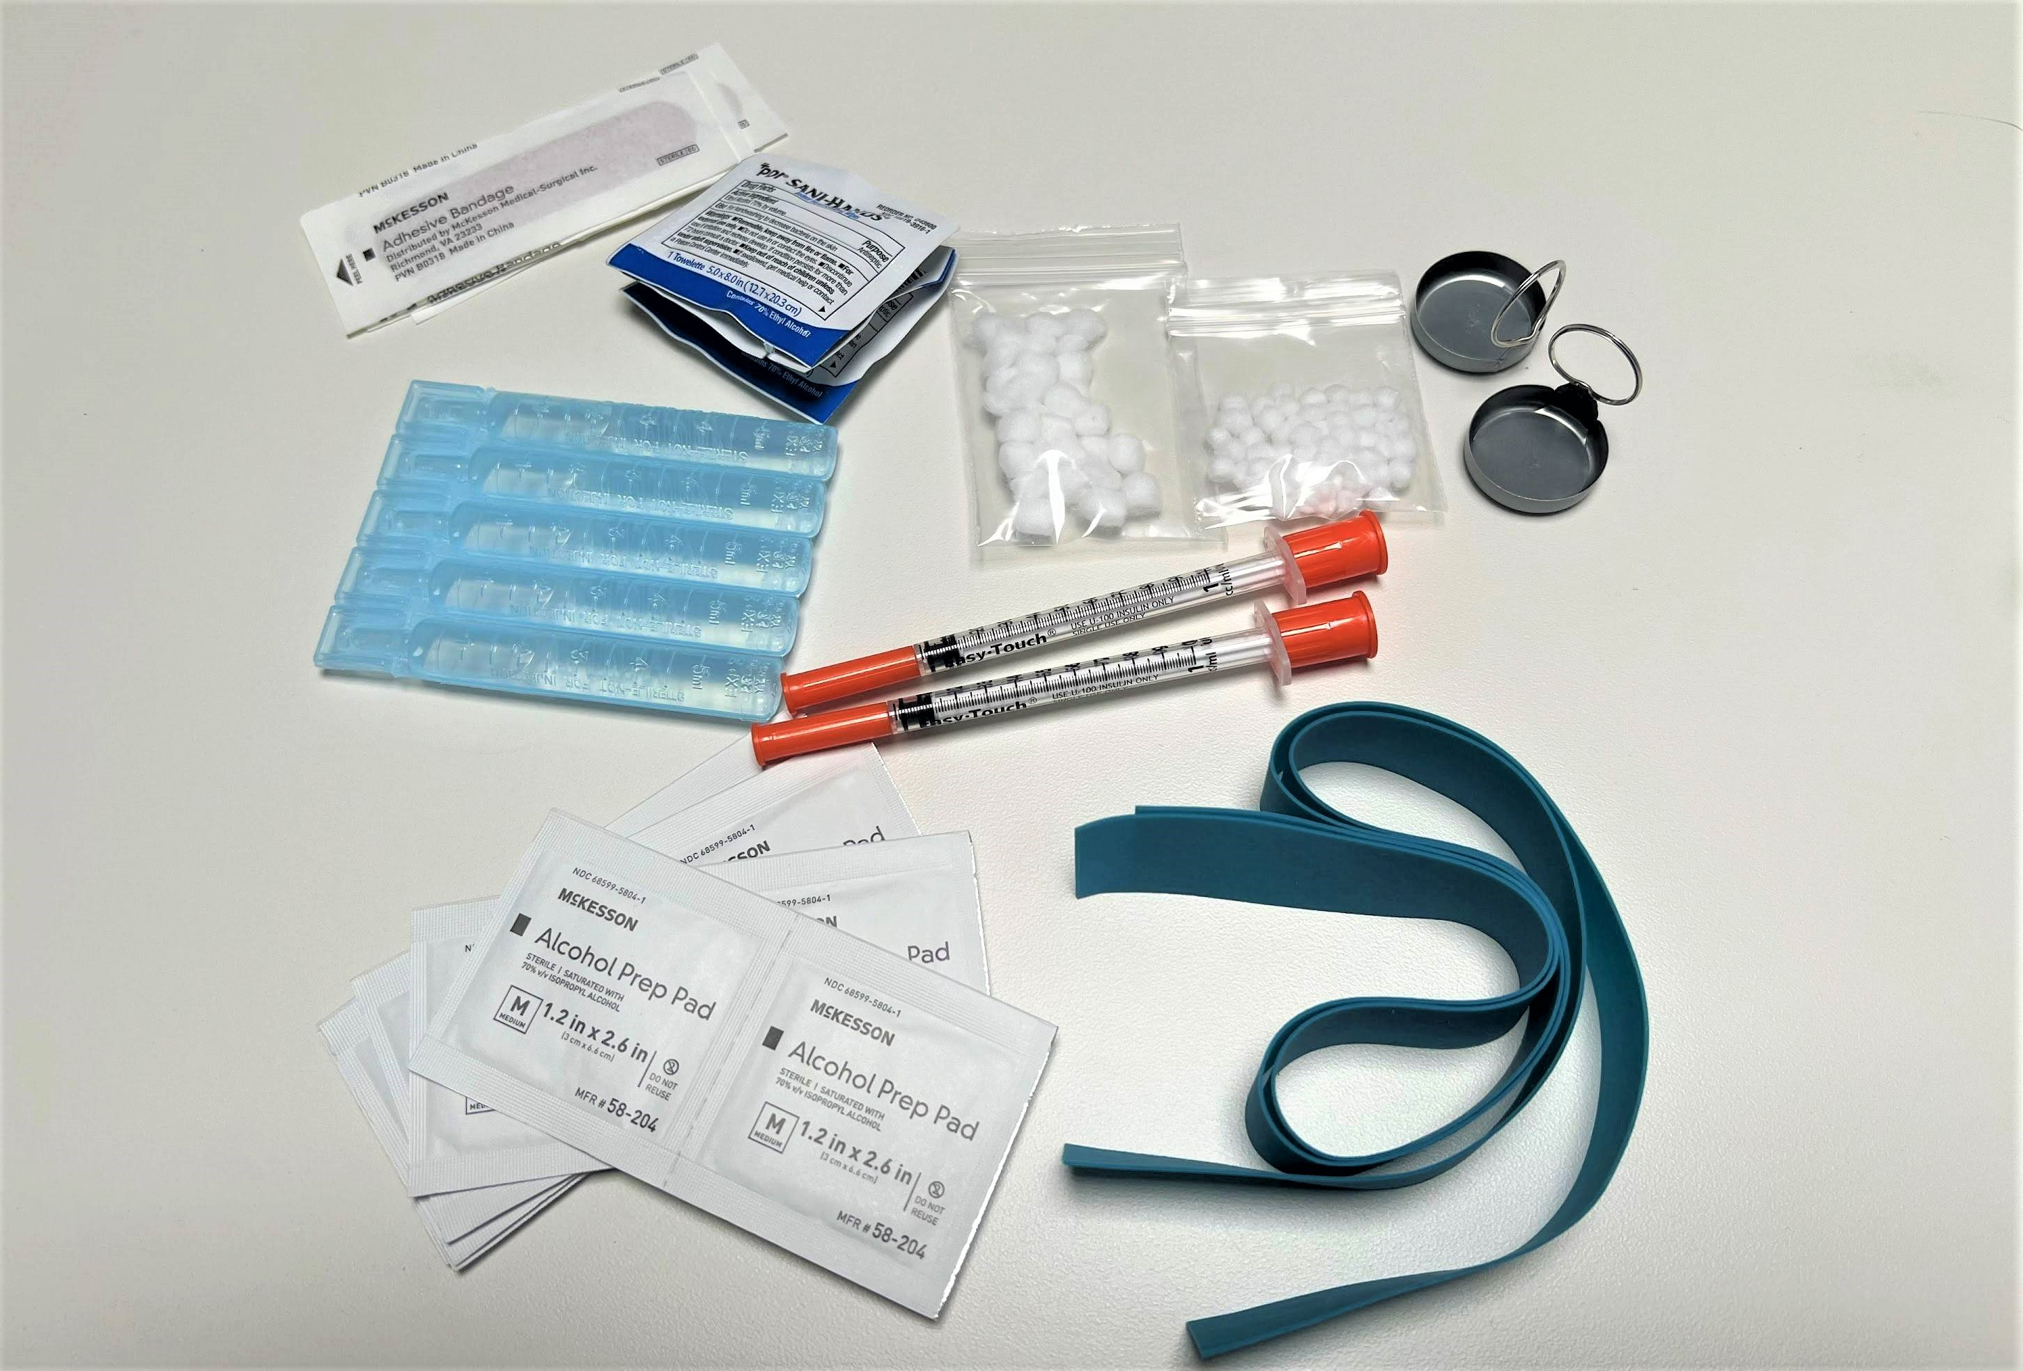
Injection Drug Use Equipment
Band-Aids
Hand Wipes
Cookers
Cotton Balls
Sterile Water
Needles & Syringes
Alcohol Wipes
Tourniquet
Photo courtesy of the Hepatitis Education Project, Seattle, WA
Notes:
With regards to harm reduction messaging for injection drug use, there are several ways individuals can reduce their risk of infection and practice safer use. When using, individuals will often heat up or dissolve their drug in a cooker. This is typically done with a small amount of water in a mini aluminum cup or a spoon. Individuals will then draw up the drug, often using a cotton ball as a filter. Reusing any of this injection equipment, including the needles, syringes, cookers, cottons or water can transmit blood-borne pathogens such as HIV, hepatitis B and hepatitis C, and it is important for individuals who use drugs to understand that sharing any injecting equipment, not just needles, can place them at risk for blood borne pathogens exposure. Using contaminated water or a contaminated acidification agent, such as lemon water, to mix and dissolve drugs can also place individuals at risk for infections with gram negative bacilli and candida, even if these mixing agents are not shared. Similarly, individuals who lick their needles prior to injecting are at risk for infections with oral pathogens, and injecting through an uncleaned area of skin can place individuals at risk for blood stream infections with common skin bacteria such as Staph and Strep. Syringe service programs typically offer all of these materials free of charge, and are a great resource for patients who use drugs.

Slide 11
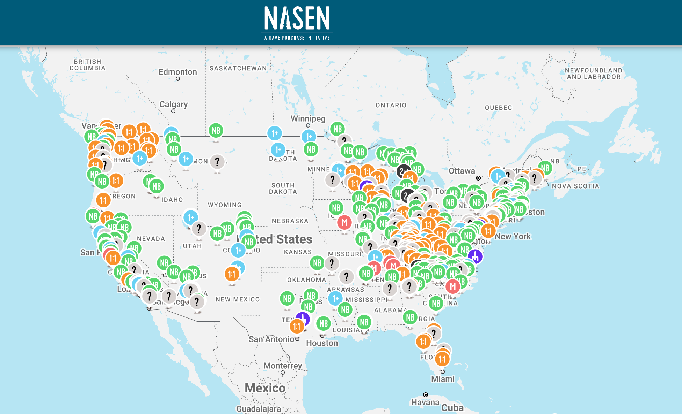
Syringe Service Program Locations
North American Syringe Exchange Network (NASEN), www.nasen.org
Notes:
The North American Syringe Exchange Network or NASEN maintains a directory of syringe service programs across the U.S. Syringe service program locations and hours of operation can be found on their website, as well as other information about SSP services. This directory is free to the public. To find out if there is an SSP in your area, visit www.nasen.org

Slide 12
Medications for Opioid Use Disorder (MOUD)
Buprenorphine-naloxone and methadone reduce risk of:
Acquiring HCV in PWID
Illicit opioid use, injection drug use, and sharing of injection equipment
Overdose death among persons on treatment.
JAMA Intern Med. 2014 Dec;174(12):1974-81.
Cochrane Database Syst Rev. 2011 Aug10;(8):CD004145
Addiction. 2020 Sep;115(9):1683-1694
Notes:
Medications for opioid use disorder are another evidenced based intervention that can help minimizing the risks related to injection drug use. These medications, including buprenorphoine-naloxone and methadone, have been shown to reduce the risk of acquiring HCV in PWID, likely by reducing overall non-prescription opioid use as well as injection drug use, and reducing sharing of injection equipment. Medications for opioid use disorder have also been shown to reduce the risk of overdose death among persons on treatment, and because of these proven benefits, it is important that providers discuss these treatment options with patients and initiate appropriate treatment plans or referrals.

Slide 13
Options for MOUD
Methadone
Full opioid agonist prescribed and dosed through a methadone maintenance program.
Patients visit the methadone program daily for dosing.
Many formulations are available, but the oral liquid form is used in most methadone clinics.
Buprenorphine
Partial opioid agonist that can be prescribed like other prescription medications in an office setting
Often co-formulated with naloxone (Suboxone)
Typically administered transmucosally 1-3 times a day; however, a monthly extended-release injection is also available.
Notes:
The two most commonly used medications for opioid use disorder include methadone and buprenorphine, which is the active ingredient in drugs like Suboxone, Subutex, and Sublocade. Methadone is a full opioid agonist prescribed and dosed through highly regulated methadone maintenance programs, where patients typically go to receive daily dosing. While there are many formulations of methadone available, most methadone clinics use the liquid formulation. Buprenorphine on the other hand is a partial opioid agonist that can be prescribed like other prescription medications in an office-based setting. Buprenorphine is most often coformulated with naloxone in a drug known as Suboxone and administered as a strip or tablet that is dissolved transmucosally in the mouth 1-3 times a day. While naloxone, an opioid antagonist, has very little bioavailability when given transmucosally, the addition of naloxone to buprenorphine is meant to discourage individuals from crushing the tablets and dissolving them for intravenous injection or dissolving the soluble film for injection.
The decision regarding which of these medications for opioid use disorder to use in an individual patient depends largely on patient factors, including patient preference, and availability of methadone and buprenorphine prescribers in an individual community. While providers used to be required to complete several hours of training and apply to the DEA for an x-waiver prior to being able to prescribe buprenorphine, these requirements are no longer in place, and all practitioners who have a current DEA registration that includes Schedule III authority, may now prescribe buprenorphine for Opioid Use Disorder in their practice if permitted by applicable state law.

Slide 14
Notes:
To learn more about hepatitis C, please check out our online hepatitis C curriculum, which contains a variety of lessons, cases and slides to reinforce your knowledge. Thanks for joining me today.

