Slide 1
Management of HCV and HIV Coinfection
Maria Corcorran, MD, MPH
Associate Editor, Hepatitis C Online and Hepatitis B Online
Assistant Professor Division of Allergy and Infectious Diseases
University of Washington
Last Updated: July 30, 2023

Slide 2
Disclosures
None

Slide 3
Epidemiology
Coinfection with hepatitis C virus (HCV) and HIV is common, owing to shared risk factors.
All persons with HIV should be screened for HCV.
Among persons living with HIV in the U.S., an estimated 15 to 30% have HCV coinfection.
In the U.S., approximately 5% of persons with chronic HCV have HIV coinfection.
Source: Bosh KA, et al. Epidemiol Infect 2018;146:920-30; Platt L, et al. Lancet Infect Dis. 2016;16:797-808; Crowell TA, et al. J Acquir Immune Defic Syndr. 2015;68:425-31; Kim AY, et al. J Infect Dis. 2013;207 Suppl 1(Suppl 1):S1-6.

Slide 4
Prevalence and Incidence of HCV Infection in MSM: Systematic Review and Meta-Analysis
Systematic review and meta-analysis evaluating HCV prevalence and incidence in MSM.
Pooled HCV prevalence in MSM was 3.4%
1.5% in HIV-negative MSM
6.3% in HIV-positive MSM
In HIV-negative MSM, pooled HCV incidence was:
0.12/1000 PY in individuals not on PrEP
14.80/1000 PY in individuals on PrEP
Source: Jin F, et al. Lancet Gastroenterol Hepatol 2021;6(1):39-56.

Slide 5
HCV and HIV: Natural History
Coinfection with HIV accelerates the progression of hepatic fibrosis in patients with HCV, and patient w/ HIV are less likely to spontaneously clear HCV.
Cirrhosis has been observed to occur 12 to 16 years earlier in persons with HCV + HIV vs. HCV alone.
Up to 80-90% of liver-related deaths in persons living with HIV are attributable to HCV infection.
Sources: Kirk GD, et al. Ann Inter Med. 2013:158:658-66; Di Martino V, et al. Hepatology. 2001;34:1193-9; Graham CS, et al. Clin Infect Dis. 2001 Aug 15;33(4):562-9.

Slide 6
Pre-Treatment Assessment
Assess fibrosis
Non-invasive tests (e.g., FIB-4)
Transient elastography (e.g., FibroScan)
Liver biopsy is the gold standard but not routinely recommended
Laboratory evaluation
CBC, CMP
HCV RNA
HBV serologic testing
+/- HCV genotype in patients with cirrhosis
Medication and drug-drug interaction review
Source: Opportunistic Infections Guidelines. Hepatitis C. January 18, 2023

Slide 7
HCV Treatment Outcomes in Patients with HIV
Source: Hepatitis C Online (www.hepatitisc.uw.edu)

Slide 8
Glecaprevir-Pibrentasvir
First pangenotypic NS3/4A protease inhibitor-NS5A inhibitor combination to be approved
Not an option for patients with decompensated cirrhosis due to the presence of a protease inhibitor.
SVR-12 rates ≥95% for treatment naïve individuals with and without compensated cirrhosis

Slide 9
Glecaprevir-Pibrentasvir in Patients with HIV-HCV Coinfection EXPEDITION-2: Study Features
Design: Open-label, phase 3 trial to evaluate the safety and efficacy of the fixed-dose combination of glecaprevir-pibrentasvir for 8 or 12 weeks in persons with HIV-HCV coinfection, without or with compensated cirrhosis
Setting: Australia, Europe, Russian Federation, UK, US
Key Eligibility Criteria
Adults with chronic HCV GT 1, 2, 3, 4, 5, or 6
HCV RNA ≥1,000 IU/mL at screening
Naïve or treated with peginterferon +/- ribavirin (PR) or PR +/- sofosbuvir
Compensated cirrhosis allowed
On ART or ART-naïve with CD4 ≥500 cells/mm³ or CD4 percentage ≥29%
Primary End Point: SVR12
Source: Rockstroh JK, et al. Clin Infect Dis. 2018;67:1010-7.

Slide 10
Glecaprevir-Pibrentasvir in Patients with HIV-HCV Coinfection EXPEDITION-2: Study Design
Week
0
4
8
12
16
20
24
GT 1-6
Non-Cirrhotic n = 137
GLE-PIB
SVR12
GT 1-6
Cirrhotic n = 16
GLE-PIB
SVR12
Abbreviations: GLE-PIB = Glecaprevir-pibrentasvir
Drug Dosing: Glecaprevir-pibrentasvir (100/40 mg) fixed-dose combination; three pills (300/120 mg) once daily
Source: Rockstroh JK, et al. Clin Infect Dis. 2018;67:1010-7.

Slide 11
Glecaprevir-Pibrentasvir in Patients with HIV-HCV Coinfection EXPEDITION-2: Results
(95% CI, 96-100)
150/153
150/151
One GT3 patient with cirrhosis and 85% compliance had on-treatment virologic failure
Abbreviations: ITT = Intent-to-treat; mITT = modified intent-to-treat
Source: Rockstroh JK, et al. Clin Infect Dis. 2018;67:1010-7.

Slide 12
Glecaprevir-Pibrentasvir in Patients with HIV-HCV Coinfection EXPEDITION-2: Results
EXPEDITION-2: Overall SVR by Treatment Regimen
(95% CI, 93-99.9)
136/136*
14/15
*Excludes one patient with missing data who achieved SVR24
Source: Rockstroh JK, et al. Clin Infect Dis. 2018;67:1010-7.

Slide 13
Sofosbuvir-Velpatasvir
Pangenotypic NS5A-NS5B inhibitor, given as a single pill combination.
Safe for use in patients with decompensated cirrhosis.
SVR-12 rates ≥95% for treatment naïve individuals with and without compensated cirrhosis

Slide 14
Sofosbuvir-Velpatasvir in Patients with HIV-HCV Coinfection ASTRAL-5: Study Features
Design: Single-arm, open-label, multicenter, phase 3 trial of sofosbuvir-velpatasvir in HIV-HCV coinfected treatment-naïve and treatment-experienced patients with genotypes 1-6 HCV
Setting: Multiple sites in US
Entry Criteria
Chronic HCV GT 1-6
Age ≥18 years
HIV coinfection
CD4 count ≥100 cells/mm³ and HIV RNA ≤50 copies/mL
On stable ART for ≥8 weeks
Prior treatment failure allowed (but no prior NS5A or NS5B)
Patients with compensated cirrhosis allowed
Primary End Point: SVR12
Source: Wyles D, et al. Clin Infect Dis. 2017;65:6-12.

Slide 15
Sofosbuvir-Velpatasvir in Patients with HIV-HCV Coinfection ASTRAL-5: Study Design
Week
0
12
24
HIV-HCV Coinfected
Treatment-naïve or Treatment-experienced
GT 1, 2, 3, 4, or 6
Sofosbuvir-Velpatasvir
n = 106
SVR12
Drug Dosing: Sofosbuvir-velpatasvir (400/100 mg): fixed-dose combination; one pill once daily
Source: Wyles D, et al. Clin Infect Dis. 2017;65:6-12.

Slide 16
Sofosbuvir-Velpatasvir in Patients with HIV-HCV Coinfection ASTRAL-5: Results
SVR12 Results by Genotype
2 Relapses
1 LTFU
1 LTFU
1 Withdrew
Consent
101/106
63/66
11/12
11/11
11/12
5/5
Source: Wyles D, et al. Clin Infect Dis. 2017;65:6-12.

Slide 17
Sofosbuvir-Velpatasvir in Patients with HIV-HCV Coinfection ASTRAL-5: Results
SVR12 Results by Treatment Experience and Cirrhosis Status
101/106
210/218
71/75
139/144
30/31
42/44
82/87
27/28
19/19
Treatment Experience
Cirrhosis Status
Source: Wyles D, et al. Clin Infect Dis. 2017;65:6-12.

Slide 18
Sofosbuvir-Velpatasvir with Minimal Monitoring +/- HIV Coinfection ACTG A5360 (MINMON): Study Overview
Design: Phase 4 open-label single-arm trial to examine the safety and efficacy of a minimal monitoring approach to HCV care delivery using 12 weeks of sofosbuvir-velpatasvir in treatment-naïve patients
Setting: Multiple sites in Brazil, South Africa, Thailand, Uganda & United States
Entry criteria:
Chronic HCV infection as determined by HCV RNA >1000 IU/mL
Treatment-naïve
Age 18 years or older
HIV coinfection permitted
Compensated cirrhosis permitted (FIB-4 ≥3.25, capped at ≤20% participants)
Absence of coinfection with HBV
Primary End-point: SVR ≥22 weeks post-treatment initiation
Source: Solomon SS, et al. Lancet Gastroenterol Hepatol. 2022;7:307-17.

Slide 19
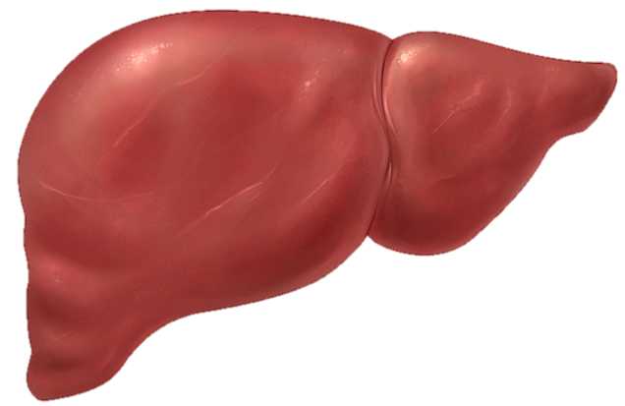
Sofosbuvir-Velpatasvir with Minimal Monitoring +/- HIV Coinfection ACTG A5360 (MINMON):
No Genotype
No pre-treatment genotyping
Cirrhosis determination based on Fib-4
All treatment medication provided at entry
No scheduled on treatment visits/labs
Remote contact at weeks 4 and 22
X
Cirrhosis Status by Fib-4
SVR
Sofosbuvir-Velpatasvir (SOF-VEL)
All pills provided at Entry
0
4
8
12
16
20
22
24
Sofosbuvir-Velpatasvir
Week
Source: Solomon SS, et al. Lancet Gastroenterol Hepatol. 2022;7:307-17.

Slide 20
Sofosbuvir-Velpatasvir with Minimal Monitoring +/- HIV Coinfection ACTG A5360 (MINMON): Study Population
Baseline Characteristic | Sofosbuvir-Velpatasvir (n = 399)
Age, median (range) | 47 (20-82)
Female sex at birth, n (%) | 139 (35)
Identity across transgender spectrum, n (%) | 22 (6)
Race, n (%) White Black Asian | 166 (42) 72 (18) 113 (28)
HCV RNA log₁₀ IU/mL, median (IQR) | 6.1 (5.6 – 6.6)
Current injection drug use, n (%) | 12 (3)
Current alcohol use, n (%) | 161 (40%)
Cirrhosis (by FIB-4 ≥3.25), n (%) | 34 (9)
HIV coinfection, n (%) Suppressed on antiretroviral therapy, n (% of HIV/HCV) | 166 (42) 164 (99)
IQR, interquartile range; FIB-4, Fibrosis-4 index
Source: Solomon SS, et al. Lancet Gastroenterol Hepatol. 2022;7:307-17.

Slide 21
Sofosbuvir-Velpatasvir with Minimal Monitoring +/- HIV Coinfection ACTG A5360 (MINMON): Results, Overall and by HIV Status
(95% CI, 92-97)
(95% CI, 92-97)
(95% CI, 90-97)
379/399
222/233
157/166
Source: Solomon SS, et al. Lancet Gastroenterol Hepatol. 2022;7:307-17.

Slide 22
Recommendations for HCV Treatment in PLWH
Treatment-naïve without cirrhosis
Glecaprevir/pibrentasvir for 8 weeks
Sofosbuvir/velpatasvir for 12 weeks
Treatment-naïve with compensated cirrhosis (GT 1,2,4-6)
Glecaprevir/pibrentasvir for 8-12 weeks^
Sofosbuvir/velpatasvir for 12 weeks
Treatment-naïve with compensated cirrhosis (GT 3)*
Glecaprevir/pibrentasvir for 8 weeks (12 week course is an alternative)
^Although 12-week duration is better studied, real world data suggest 8wk duration is ok. 12wk duration listed as “alternative” in OI guidelines
*Sofosbuvir/velpatasvir requires pre-treatment NS5A RAS testing in patients w/ GT3 + cirrhosis
- if no resistance 12wks of sofosbuvir/velpatasvir is ok; if resistance, must add ribavirin
Source: Opportunistic Infections Guidelines. Hepatitis C. January 18, 2023

Slide 23
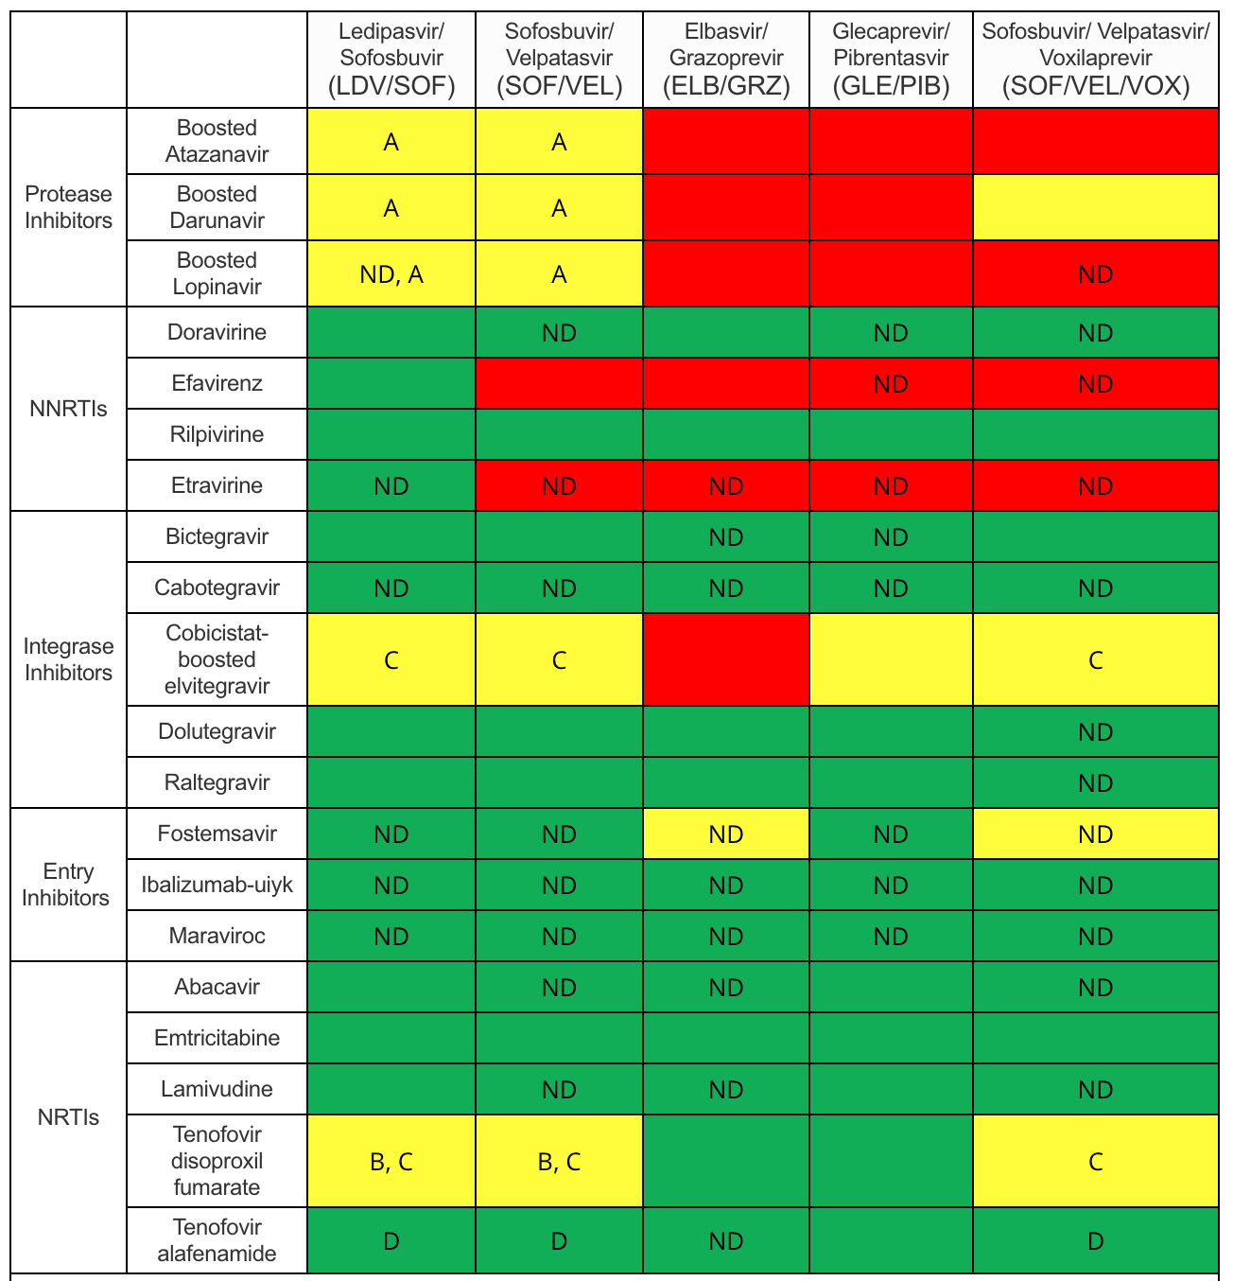
Source: HCV Guidance: Recommendations for Testing, Managing, and Treating Hepatitis C,
October 24.2022.

Slide 24
Laboratory Monitoring
Most patients will not require any on-treatment laboratory monitoring.
Patients taking diabetes medications should monitor for hypoglycemia.
Patients on warfarin should have INR monitoring to evaluate for subtherapeutic anticoagulation.
In patients with compensated cirrhosis, providers may order liver function testing to monitor for liver injury during treatment.
All patients should undergo repeat HCV RNA and liver function testing 12 weeks post-treatment to assess for HCV cure and transaminase normalization.
Source: AASLD/IDSA HCV Guidance: Recommendations for Testing, Managing, and Treating Hepatitis C

Slide 25
Conclusions
HIV and HCV coinfection is common, owing to shared risk factors.
Coinfection with HIV accelerates the progression of hepatic fibrosis in patients with HCV, and HCV is the leading cause of liver-related deaths in PLWH.
Glecaprevir/pibrentasvir and sofosbuvir/velpatasvir are the preferred regimens to treat HCV in patients w/ and w/o HIV due to their efficacy and pangenotypic activity.
Many patients with HIV can be treated for HCV using a minimal monitoring approach, and most will need on-treatment monitoring.
Preferred HCV treatment regimens have limited interactions with most first line ART, but important drug-drug interactions with PIs and NNRTIs exist.

Slide 26
Notes:
To learn more about hepatitis C, please check out our online hepatitis C curriculum, which contains a variety of lessons, cases and slides to reinforce your knowledge. Thanks for joining me today.

